Slide 1

UK Housing Review 2025
Autumn Briefing Paper

Slide 2
Mark Stephens
The Economy, the Spending Review and the coming Budget

Slide 3
Public expenditure and the economy
Economy provides backdrop to Budget
Low growth since GFC compounded by persistence of inflation
Key players = Treasury, Bank and OBR
Inflation limits Bank of England’s ability to cut Base Rates
But gilt yields creeping up, indicating market unease with govt finances
OBR forecast crucial for “headroom” / tax rises/ spending cuts in Budget
Treasury leading on planning reforms to convince OBR to improve forecasts
Bank has slowed bond sales (QT) – which helps government finances.

Slide 4
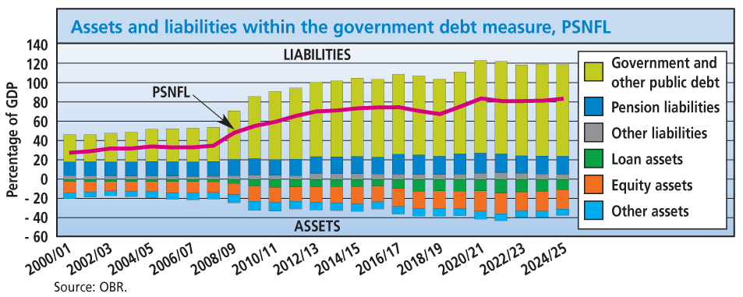
Public expenditure and the economy
SR25 set out capital spending for 4 years:
  £39bn SAHP (10 yr)
  Increased use of financial transactions, inc. £5.1bn (to 2029/30) for National Housing Bank
Resource spending (3 year) squeezed, esp. outside protected departments
Large tax rises anticipated in Budget
Sparked debates on property taxes
Another spending review in 2027.

Slide 5
Matthew Scott
Retrofit policy – will an area-based approach work?

Slide 6
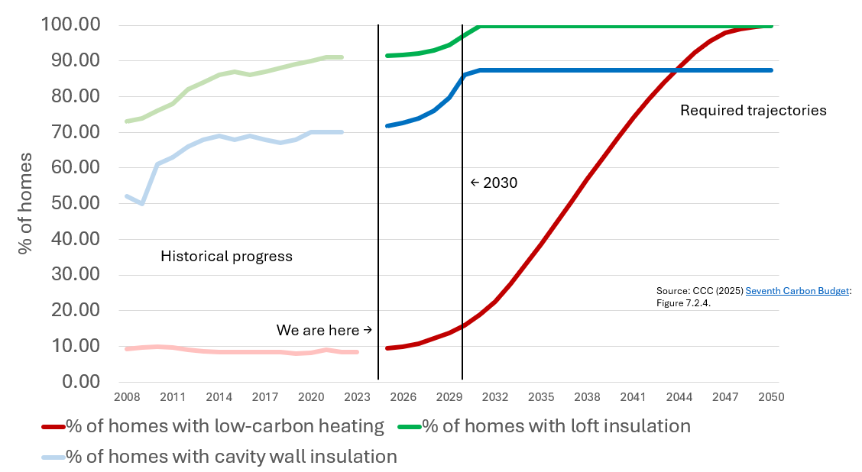
Retrofit policy – will an area-based approach work?

Slide 7
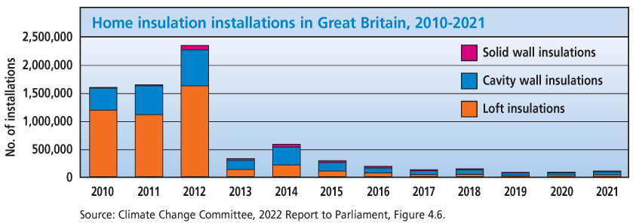
Retrofit policy – will an area-based approach work?
We are significantly off track to meet CCC CB7 trajectory
Complex targeting and eligibility criteria can slow delivery
Area-based or ‘street by street’ approaches, delivered through combined authorities, could offer a route to enhanced delivery
Will the Warm Homes Plan deliver?

Slide 8
Alice Dore
Physical disability, housing insecurity and homelessness

Slide 9
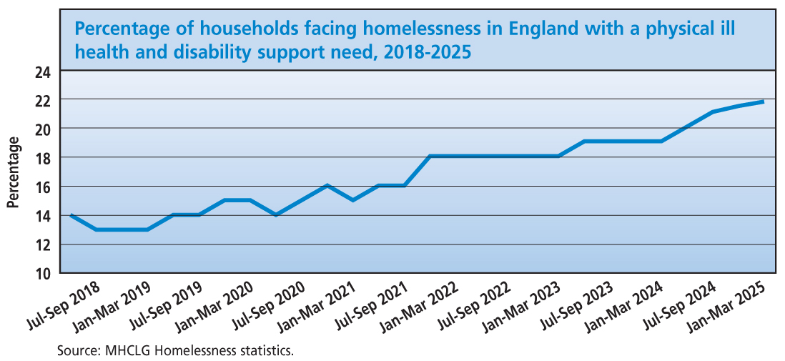
Physical disability, housing insecurity and homelessness
Victim of modern slavery
Young person
Difficulties budgeting
Access to ETE
Care leaver
Served in HM armed forces
Physical ill health and disability
Support needs assessment of homeless-ness applicants
Old age
History of mental health problems
History of repeat homelessness or rough sleeping
Learning disability
Offending history
Alcohol dependency
At risk of / has experienced violence, abuse or exploitation
Former asylum seeker
Drug dependency
14%
22%

Slide 10
Physical disability, housing insecurity and homelessness
One in three disabled people in private rented properties live in unsuitable conditions, and many face decades-long wait for accessible social housing¹
In 2023/24, 16% of social housing lettings (34,912) went to households with a disability or access-related housing needs – down from 20% (39,866) the previous year²
The majority of people experiencing homelessness surveyed reported a long-term illness or disability.³ There is evidence that health issues worsen during waits for social housing, stays in TA, and periods of rough sleeping^{4,5,6}
Barriers to health services for people experiencing homelessness.⁷
¹Levelling Up, Housing and Communities Committee (2024), Disabled people in the housing sector. Seventh report of session 2023-24
²MHCLG (2025), Social housing lettings in England
³Homeless Link (2024), Findings from the Homeless Health Needs Audit
⁴Crisis (2024) Lives on hold: understanding the consequences of waiting for social housing
⁵Shelter (2023) Living in limbo: why the use of temporary accommodation must end
⁶Crisis (2023) I always kept one eye open: the experiences and impacts of sleeping rough.
⁷Pathway (2025) Helping or harming: the homeless & inclusion health barometer 2025.

Slide 11
Kath Scanlon
London fails to meet its housing targets

Slide 12
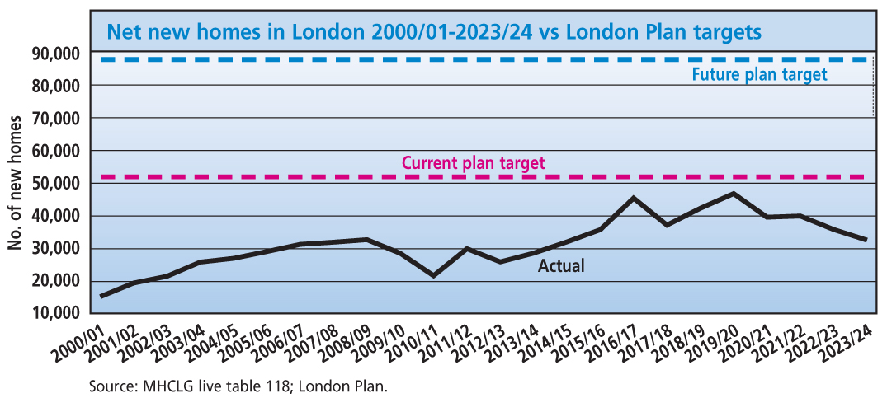
London fails to meet its housing targets
New homes
  Current target 52,000
  Future target 88,000
  2023/24 completions 33,816
Affordable homes
  Need per 2017 SHMA: 42,841
  2023/24 net new affordable homes 7274 -- of which social 8.3%

Slide 13
London fails to meet its housing targets
Why?
National factors + some that particularly affect London:
  Planning constraints including green belt (Sadiq Khan recently promised to relax constraints)
  Tighter rules for high-rise blocks post-Grenfell (high % of new London homes)
  Reliance on market development to cross-subsidise new affordable homes
What can the Mayor do?
Mayor has no direct control of housing production but can
  Set targets for overall new homes & % affordable—though boroughs are planning authorities
  Allocate AHP £ within London
  Steer use of land owned by GLA-controlled bodies eg TfL

Slide 14
Peter Williams
The private housing market and first-time buyers

Slide 15
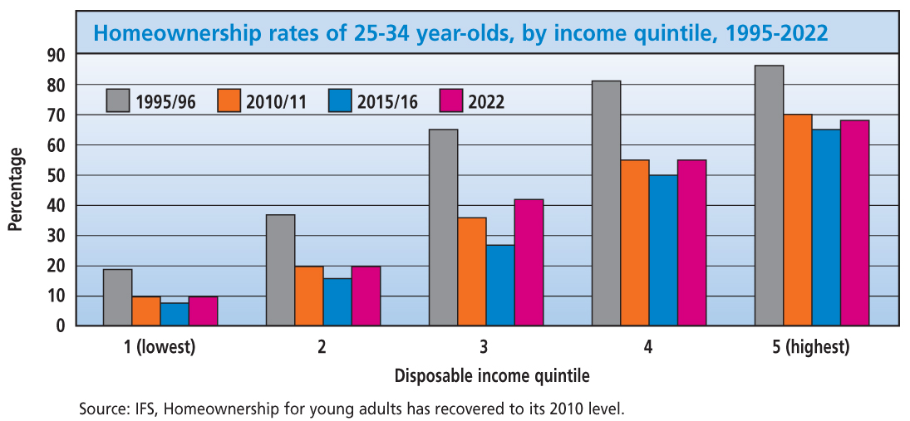
The private market and first-time buyers
Aspiration for homeownership remains strong
Push and pull but real constraints on FTBs
332,000 FTBS in 2024 , below long-term average 387,000. Rising now
Costs down, but high compared to 2021
Reliance on BOMAD
25-34 olds by income quartile - varied

Slide 16
The private market and first-time buyers
Ownership peaked in 2003 – at 71% - now down at 64%. A return?
Mortgage market has changed – outright owners dominate, market has shrunk, more tightly regulated
Lender and regulator response – higher multiples (6), easing HLTV lending cap as well as Govt Guarantee scheme – in total supporting perhaps a further 50,000 FTBs?
Loss of confidence in run up to Budget so market has slowed but await announcements – FTBs clearly a political battleground
Need clear recognition of importance of market to the economy as a whole
In long run inheritance effect will boost HO but will also boost inequality.

Slide 17
Plans for the UK Housing Review 2026

Slide 18

CIH and the UKHR team are grateful to the Ministry of Housing, Communities and Local Government, the Scottish and Welsh Governments and all of our sponsors (see panel), for their support for the Review’s production and publication

