Slide 1



HIRE FOR GRIT.
SUPERCHARGE
SOCIAL VALUE.

Slide 2
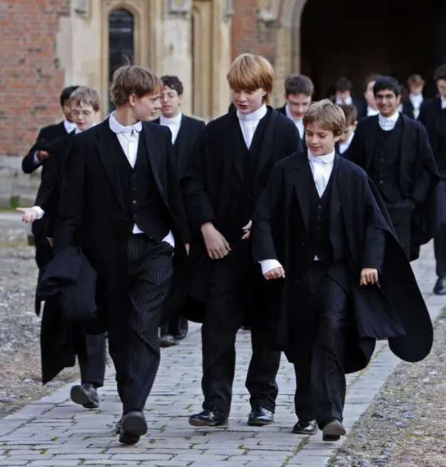

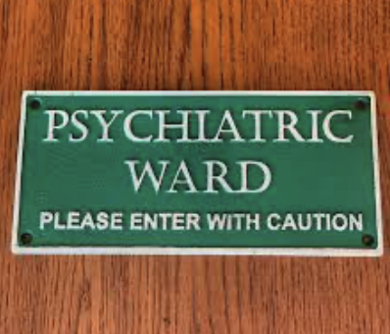
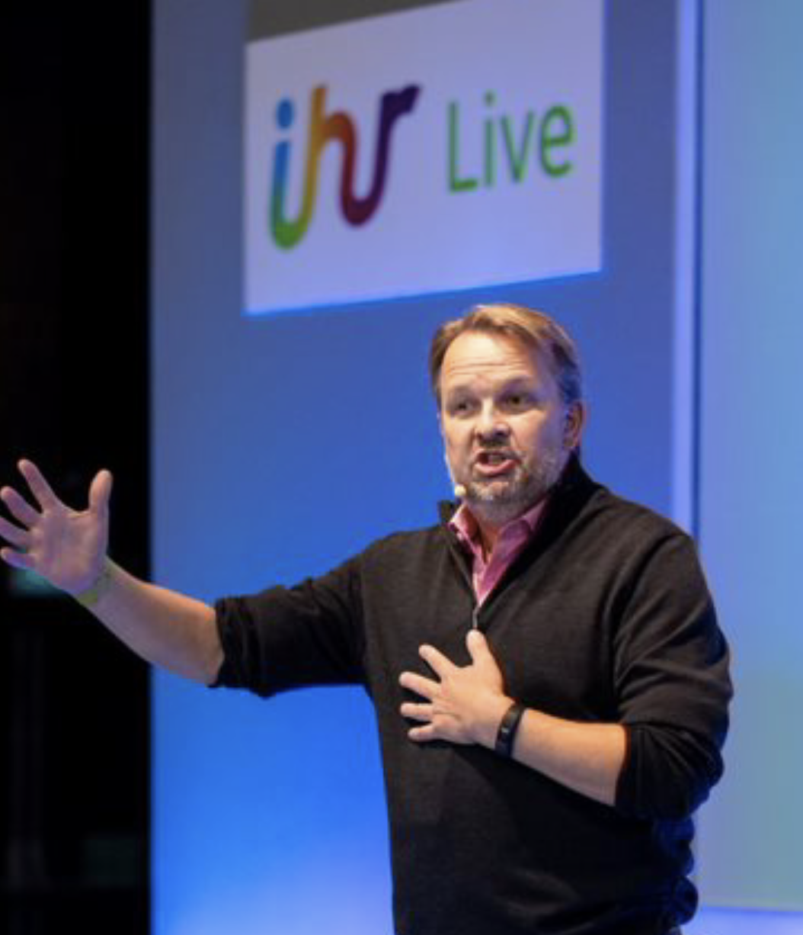
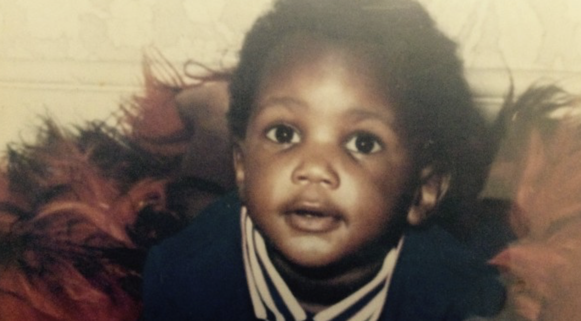

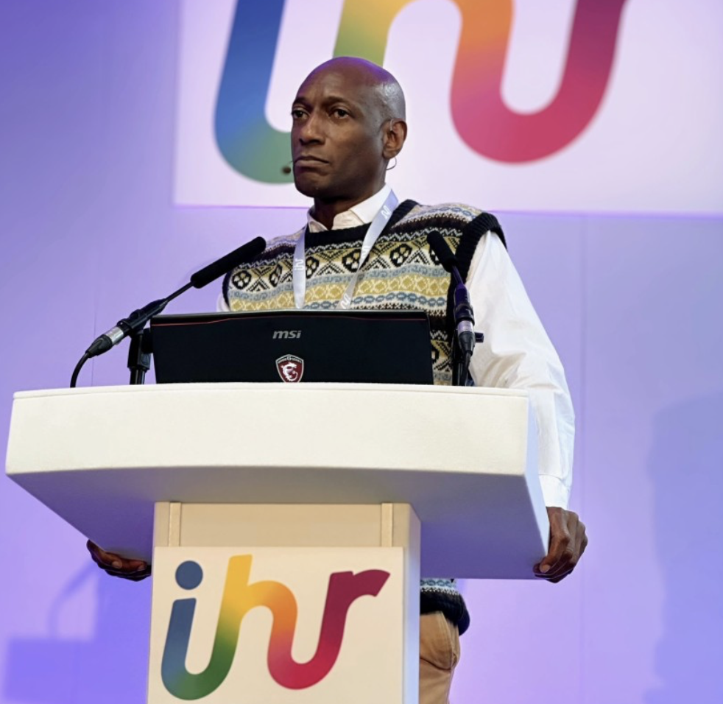
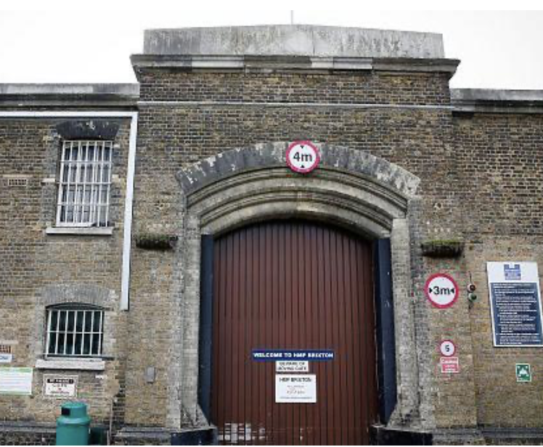
A TALE OF TWO PEOPLE
Notes:
BOTH 5 MINS
5 MINS (12 TOTAL)
FULL STORY IN CHAT
JF
1 BORN LUCKY /CAMERON /JOHNSON
2 2.5 DECADES SELLING LEGAL DRUGS – JW/SM/TANQ/G / POSTED TO US, 2008 TOP OF THE WORLD
3 LUCK RAN OUT - redundant / swindle / sue / psych ward / Maslow p / janitor / epiphany
4 NORTH STAR JOBS – POWER OF JOB - charities / connect untapped t / charity / soc ent / 1500 cands / 55 MULTI NATIONALS / tiara
CBM
1 XXX
2
3
4
GB ~ SHARE KEYNOTE:
To get the full back story, please check out this recent Keynote
https://www.youtube.com/watch?v=Dhj2bXeRVXY

Slide 3
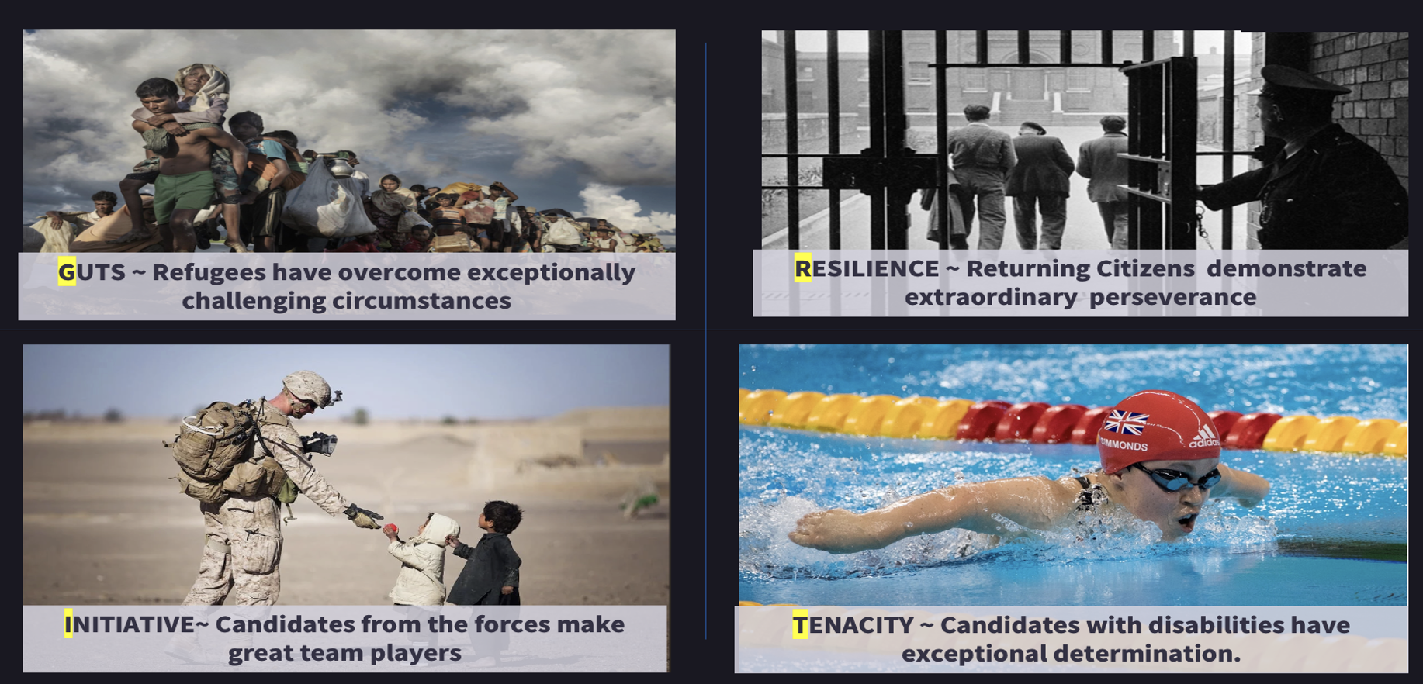
STOP HIRING FOR FIT.
HIRE FOR GRIT!
STOP HIRING FOR FIT.
HIRE FOR GRIT!
~ GRIT is the #1 predictor of career success*.
~ More than IQ, EQ, qualifications, or background.
~ When you ‘Recruit for Resilience’, you recruit for retention.
~ Candidates from under-represented groups have GRIT in spades
Hiring for GRIT is the ultimate merit-based inclusion
GRIT ~ The Ted Talk. Angela Duckworth’s 15-year research*

Slide 4


INCLUSIVE HIRING
TURBO CHARGES SOCIAL VALUE (ESG)
£56,000
£ SOCIAL VALUE GENERATED
£20,000
£300K
£846
£404
Source:
Social Value Portal
½ DAY EDI
TRAINING
50 HOURS VOLUNTEERING
INCLUSIVE
HIRING
JUSTICE-FRIENDLY HIRING

Slide 5

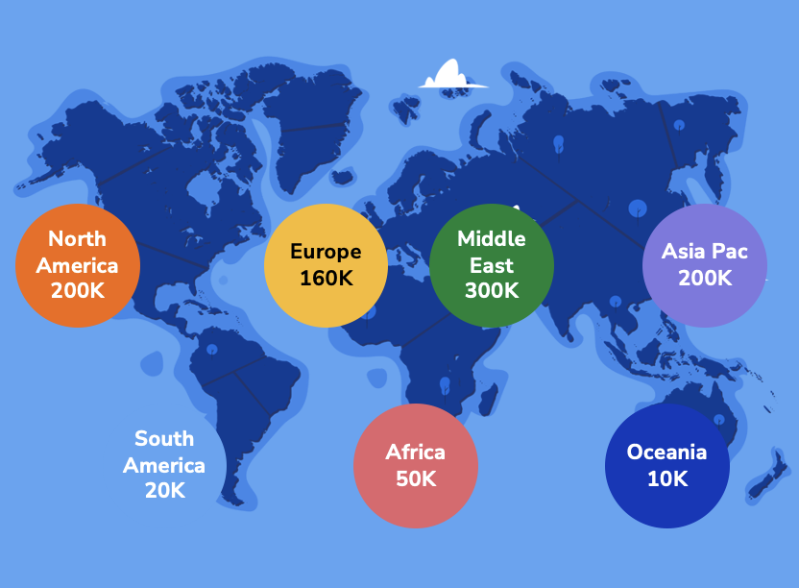
THE WORLD’S MOST INCLUSIVE TALENT POOL
> 1MILLION OVERLOOKED & GRITTY CANDIDATES
UNTAPPED TALENT POOLS ACROSS THE GLOBE
UNTAPPED TALENT POOL | CANDIDATES
NEURODIVERGENT | 20,277
REFUGEES | 11,484
THE BLIND | 9,185
THE DEAF | 7,438
SINGLE MOTHERS | 35,146
RETURNING CITIZENS | 7.047
PHYSICAL DISABILITY | 12,708
RAINBOW | 29,028

Slide 6


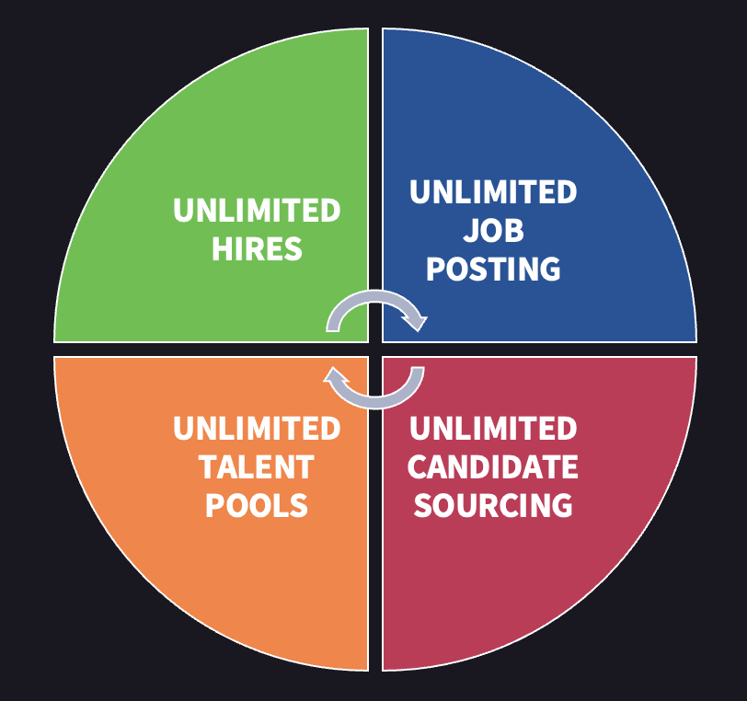
YOUR TENANTS INTO MEANINGFUL CAREERS
..AND EXPAND YOUR TALENT POOL
HELP JOB READY TENANTS / CUSTOMERS ACCESS JOBS IN BLUE-CHIP INCLUSIVE EMPLOYERS
EXPAND YOUR TALENT POOL ~ 38K ACTIVE CANDIDATES WITH ‘LIVED EXPERIENCE’

Slide 7
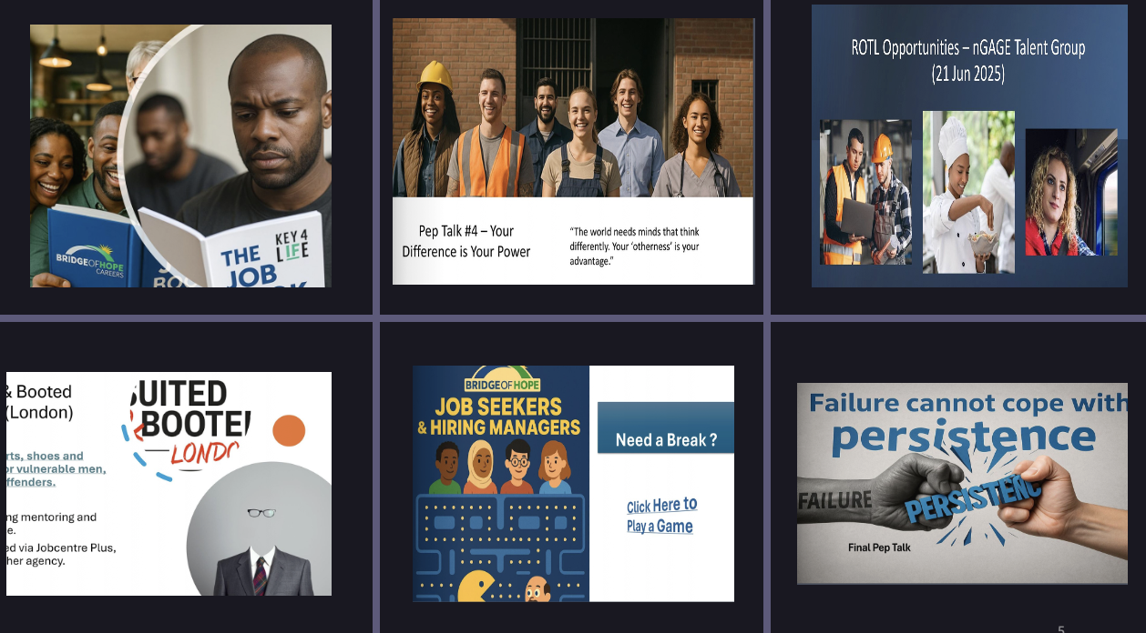

CUSTOM JOB BOOK.ON THE HOUSE
CLICK HERE TO TRY THE JOB BOOK

Slide 8



SOCIAL BOOST ~
THE MARKET’S ONLY PRECISION MEDIA SOLUTION FOR ‘UNTAPPED TALENT’
10% ACTIVE
90% ~ PASSIVE
UNTAPPED TALENT
80% ~ autistic adults unable to secure a job
86% ~ ex-offenders OOW after a year
73% ~ 18-34s found last job on social media
Diverse engineers in Barrow-in-Furness
~ Targeting over 50’s, veterans, women returners
~ 536 applications in 19 days
Click here for an
overview of the Social Boost

Slide 9
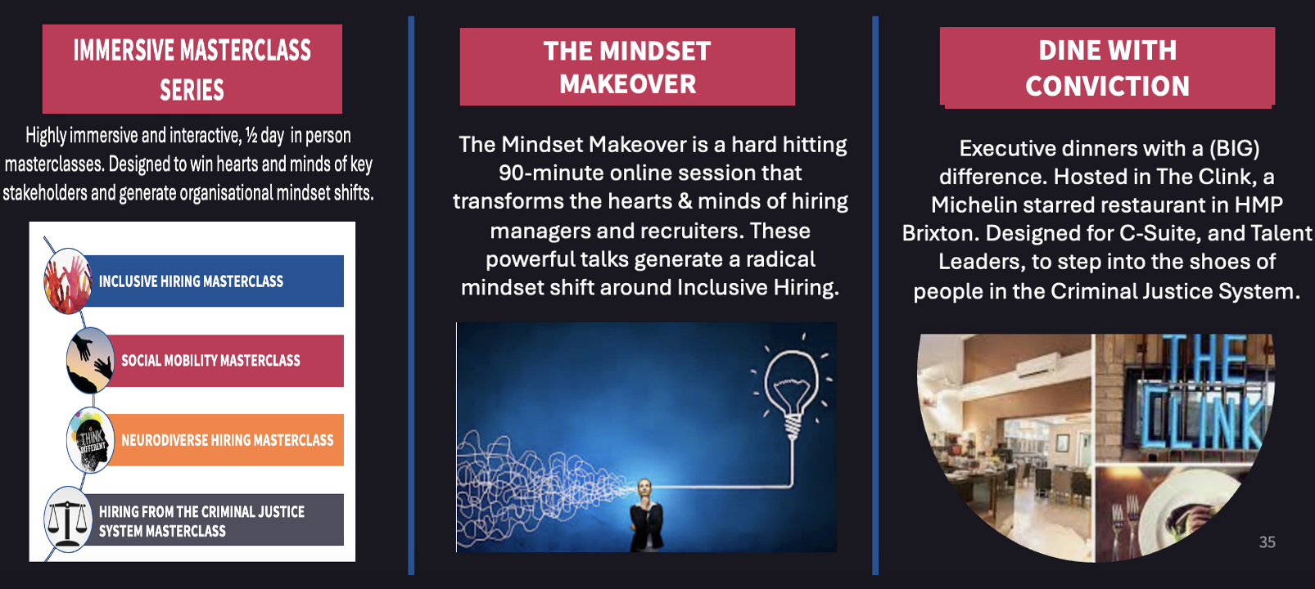
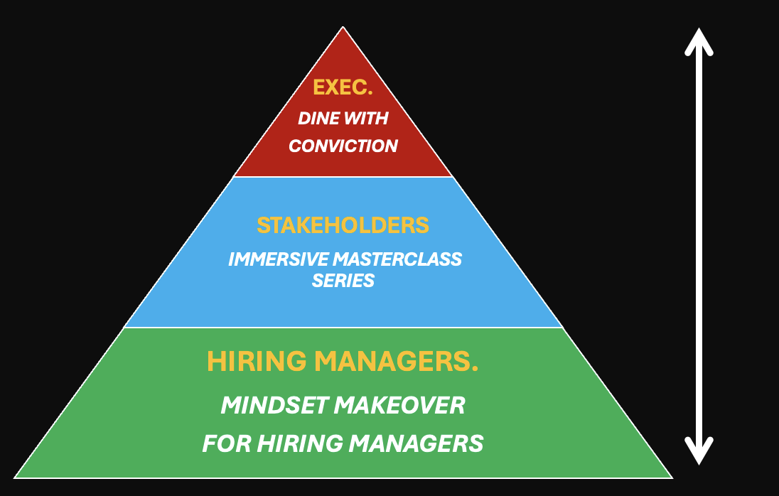
LEARNING WITH EMPATHY
CHANGING HEARTS & MINDS. AT EVERY LEVEL
CLICK HERE TO LEARN MORE ABOUT OUR LEARNING WITH EMPATHY SERIES

Slide 10


UNLEASH YOUR LEVY
RELEASE SKILLS FUNDING
UNDERSTAND
DEMYSTIFY THE LEVY
UNLOCK
~ VALUE YOUR LEVY.
~ IDENTIFY YOUR SKILLS GAPS
UNLEASH
ATTRACT EMERGING TALENT
~ UPSKILL YOUR OWN TALENT
UNEARTH
~ UNEARTH & QUANTIFY SOCIAL VALUE
UPLIFT
~ SUPPORT YOUR SUPPLY CHAIN
~ NOURISH YOUR NGO NETWORK
94% of UK employers fail to use their levy.
Gratis service for CIH Members .

Slide 11
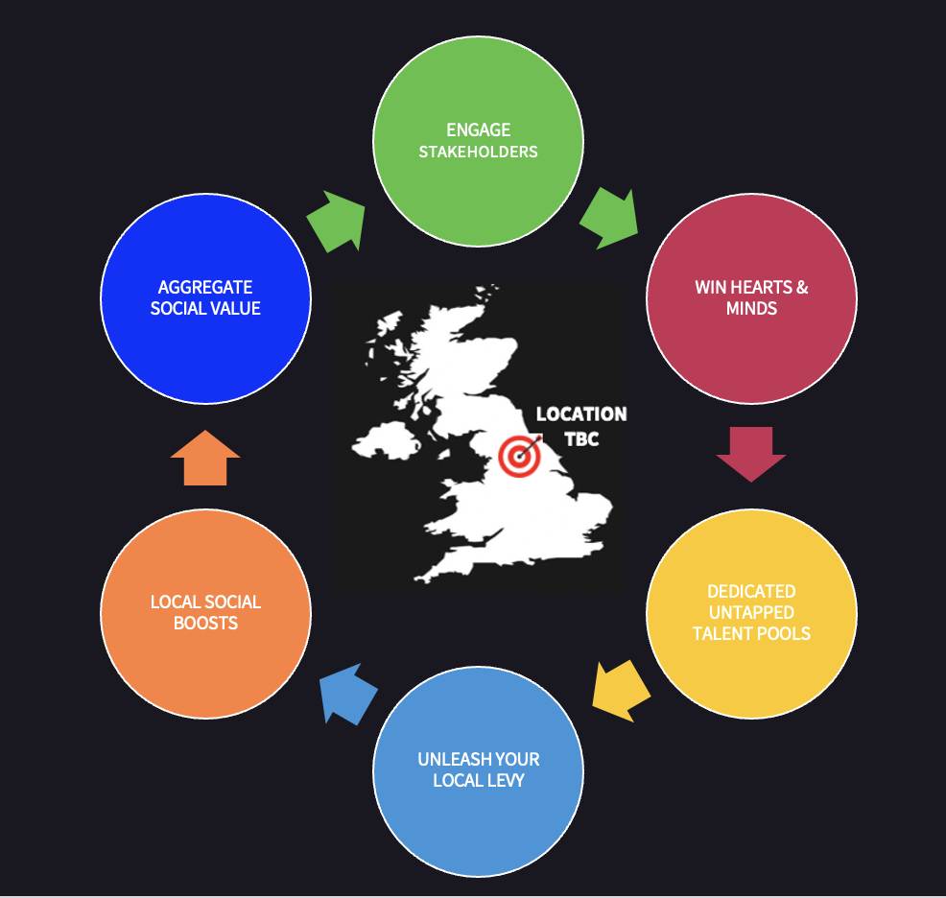
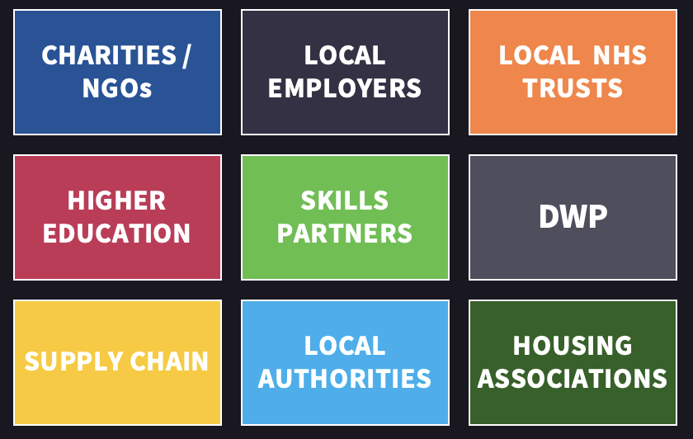




LOCAL EMPLOYMENT NETWORKS
ACCELERATE PLACE BASED SOCIAL VALUE
SPECIALIST ACTIVATION PARTNERS

Slide 12

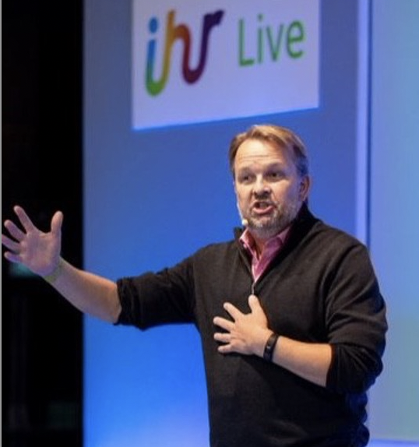
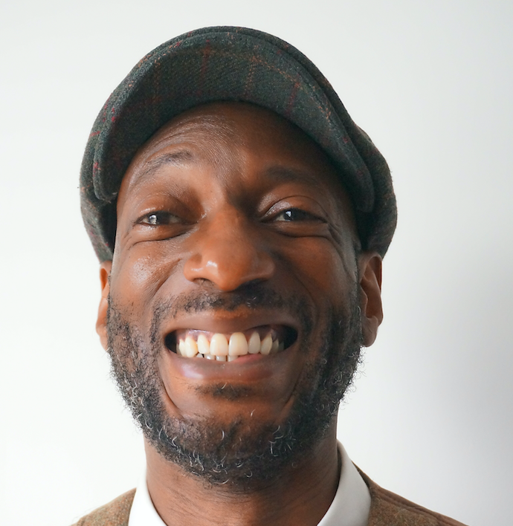
EXPAND YOUR CLIENTS TALENT POOL
UNLEASH YOUR SOCIAL VALUE
James Fellowes
Founder, Bridge of Hope
james.fellowes@bridgeofhope.careers
07391 017 158
Chance Bleu-Montgomery
Partner Support Manager
chance.bleumontgomery@bridgeofhope.careers
07936 827 844

