Slide 1
Scotland’s Housing Festival
A framework for achieving net zero owner-occupied homes
Gillian Campbell, 7 March 2023

Slide 2













Members
Supporters

Slide 3
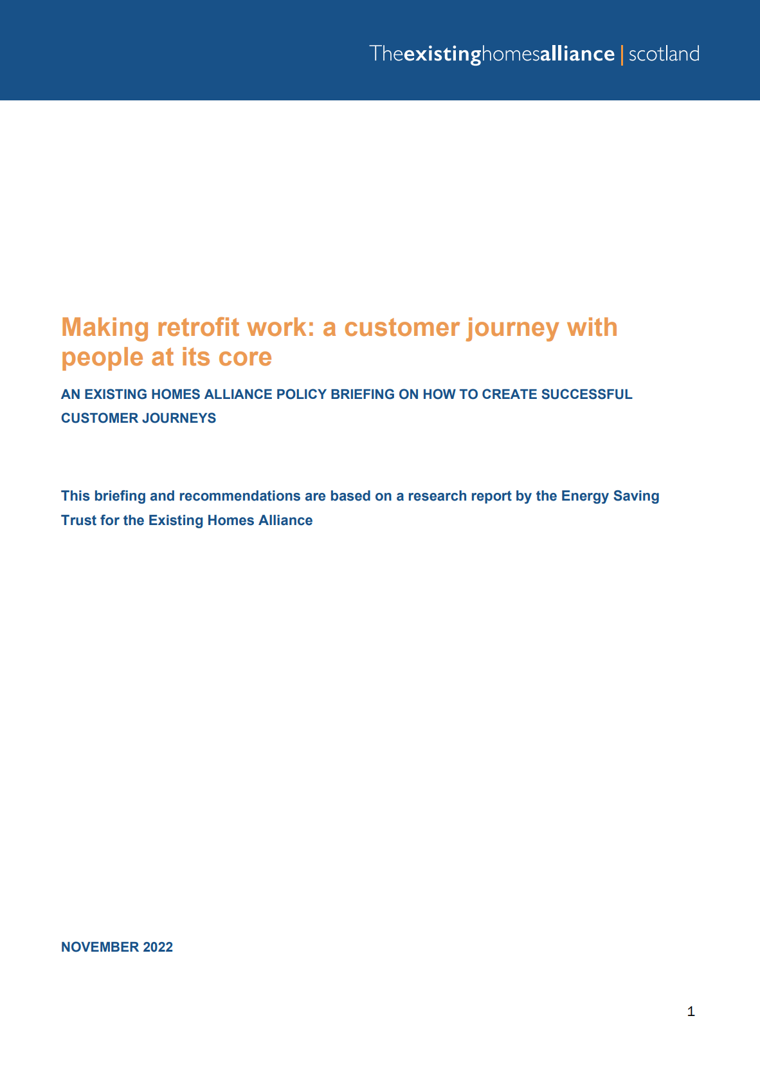
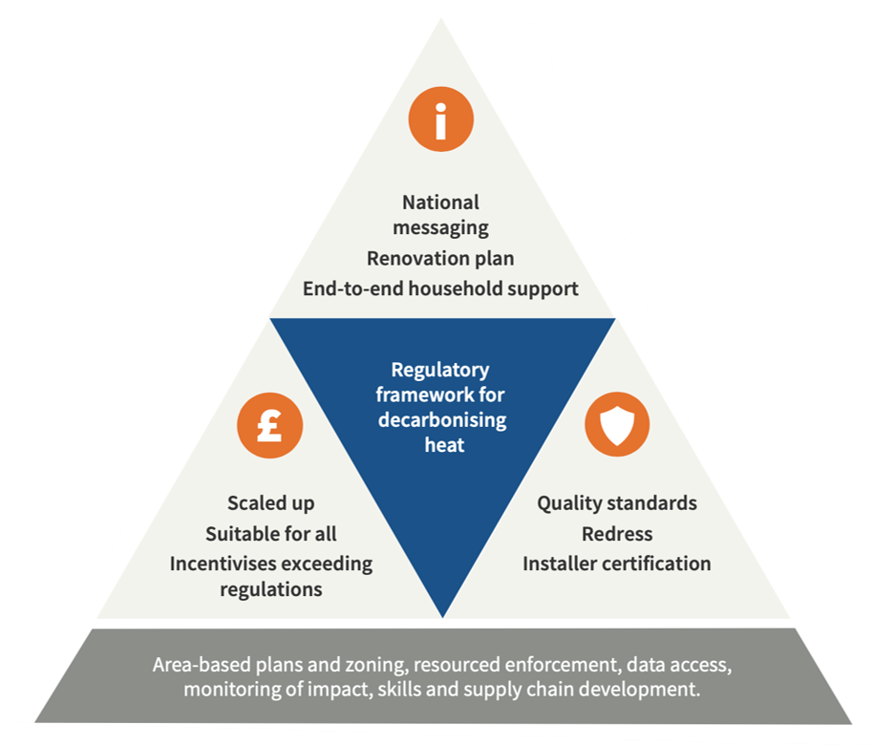
An effective enabling framework
EHA Recommended Regulations
A renewable heat ready standard for existing homes
Zero emissions heat regulations
Phased approach for tenements
We need:
People to be moving ahead of regulations
and
People to WANT to improve their homes as well as being required to do so

Slide 4
Key stages of successful customer journeys
Step 1 Raising awareness
Step 2 Finding out more and taking action
Step 4 Accessing post-installation support
Step 3 Proceeding with installation work
Clarity and certainty
One-stop shops
Project management/ coordination
Support to use new systems
Digital platform:
How-to guides
Mgt of process
QA docs & logs
Integrated financing
National & local campaigns
Local and cooperative approaches
Access to redress
Building renovation passports

Slide 5


One stop shops
Proactive engagement with owners
Energy renovation and financial plans
Coordination of the renovation process
Long-term and affordable financing
Guaranteed results and post-work monitoring

Slide 6

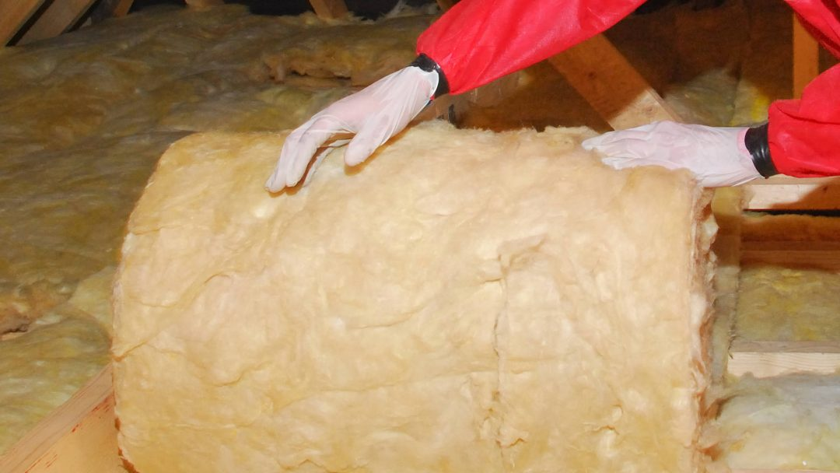
Project management/coordination
Overcome tech. knowledge gaps
Manage complexity
Whole house approach
PAS2035?
Lack of independence
Challenge for small businesses

Slide 7

Building blocks for successful customer journeys
Effective awareness raising
One-stop shops
Easy access to advice and support – digital and in person
Range of financial support mechanisms
Building Renovation Passports
Post-installation support
Easy access to redress
Access to project management/ coordination services
Community-based services
Facilitation of demand aggregation

Slide 8
existinghomesalliancescotland.co.uk info@existinghomesalliancescotland.co.uk
@existinghomes

Slide 9
Tackling disrepair in Social Housing Stock
Ian Dawson
Business Change Manager
Housing Services, Fife Council

Slide 10
Local Housing Strategy 2022 - 2027
Priority 5 – A warm low carbon home
Outcomes
  As far as reasonably practicable, people do not live in fuel poverty
  The impact of fuel poverty on people's housing circumstances is minimised
  People live in energy efficient homes

Slide 11
Ability to influence
– Energy Efficiency
Fife Council
SHQS
Fife Standard
EESSH
EESSH 2
Owner / Occupiers
Home Insulation Schemes
Universal Home Insulation Schemes
HEEPS:ABS
EES:ABS
HES
Cosy Kingdom

Slide 12
Energy Efficiency - Projects
SHQS / Fife Standard – 2015
EEESH 1 – 2020
EESSH 2 - 2032
Heating Upgrades
Window & Door replacements
External Wall Insulation
Internal Wall Insulation
Cavity Wall Insulation / Failed Cavities
Loft Insulation

Slide 13
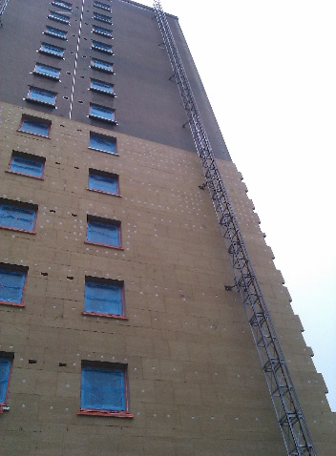
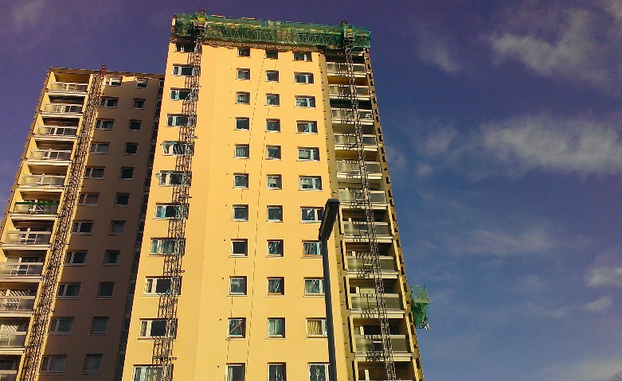
External Wall Insulation – High Rise
Mixed Tenure
Window replacements
Heating upgrades
Common area improvements
HRA Capital
ECO
HEEPS:ABS
EES:ABS

Slide 14
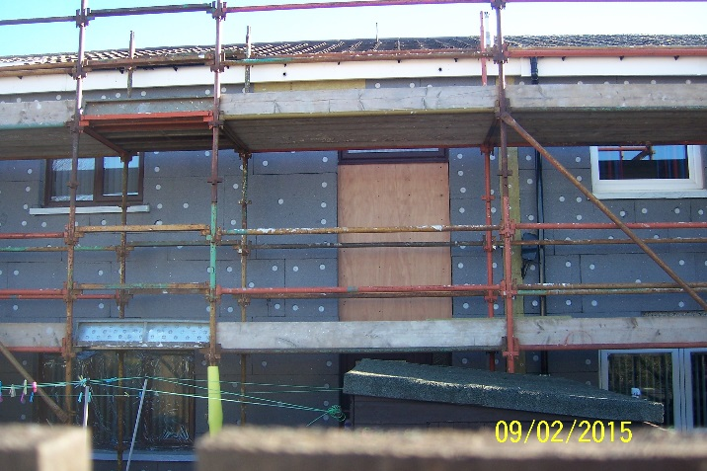
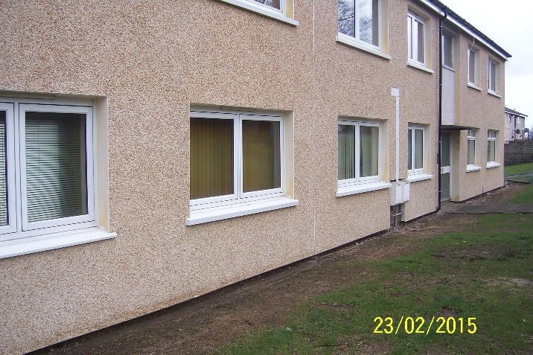
External Wall Insulation – Low Rise
Flats
Terraced Rows
Semi detached
Mixed Tenure
HEEPS:ABS
ECO
HRA Capital
SWIGA Guarantee – 25 years

Slide 15
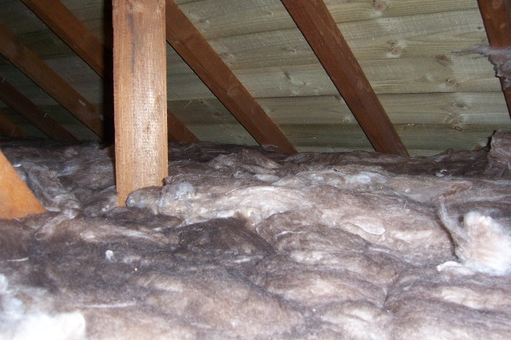
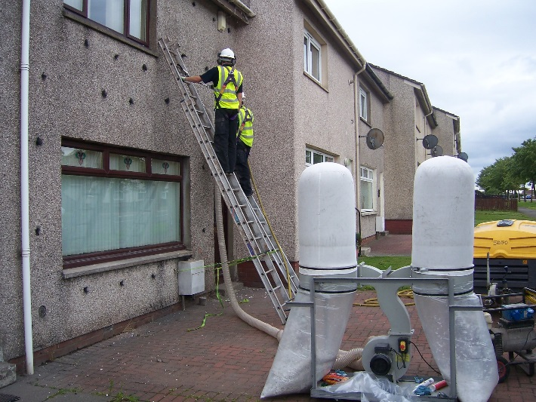
Standard Insulation
Loft
Cavity
Failed Cavities

Slide 16
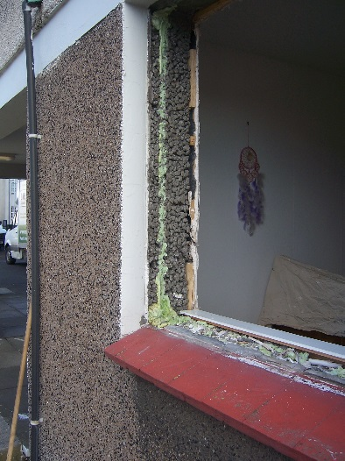
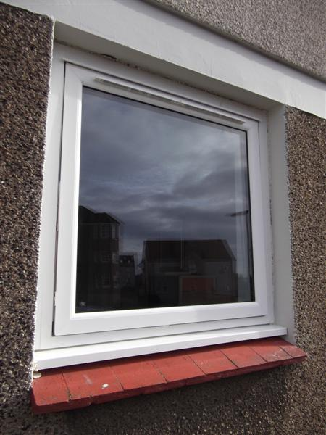
Window and Door replacements
Current standards
  Secure by design
  A+ Energy Efficiency standards rated

Slide 17
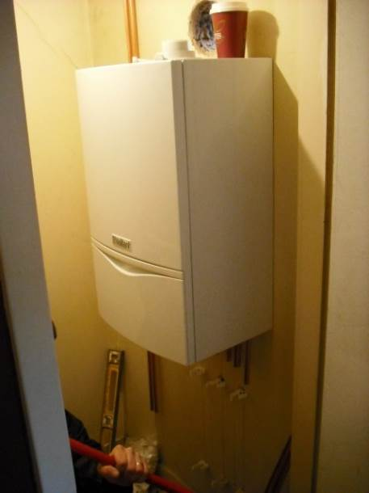
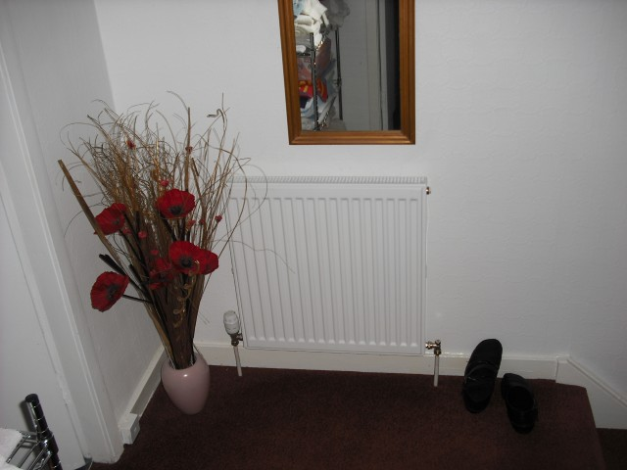
Heating Upgrades
Current SHQS standard achieved replacing all G (<70%) rated boilers except where tenants have opted out. These properties are recorded and will have heating upgrade when they become void.
Current programme now replacing all D,E,F rated boilers.
Current boiler specification are all 90%+ efficiency

Slide 18
Renewable Technology
Solar Thermal – 300 installs
Solar Photo Voltaic – 55 installs
Heat Pumps – 35 Installs
District Heating - Dunfermline & Glenrothes
Battery storage pilot
2700 New Builds – High Energy Efficiency Standards

Slide 19
Project Prioritisation
Heating Upgrades – Combination of boiler age and efficiency rating
Window and door replacement – Combination of element age and MRI Asset database stock condition information
EES:ABS projects – Fuel poverty mapping and SIMD data
Energy Saving Trust – Portfolio Energy Assessment Tool (PEAT) utilised to prioritise EESSH2 delivery plan
10 year non traditional costed plan being developed with consultant support

Slide 20
Unintended consequences
The more we increase the insulation and air tightness of the buildings the more we need to control the internal air.
New build MVHR systems are a new and misunderstood technology for tenants
Humidistat fans – bypassed
Trickle vents - blocked
Cost of living crisis
Underheated homes
Condensation & dampness issues
Black mold

Slide 21
Unintended consequences - Mitigation
Cosy Kingdom support
Direct fuel top-ups for tenants
Expanded condensation & dampness team
Revised guidance and advice for tenants
Increased referral to specialist dampness contractor
In-house dampness team being developed in partnership with Building Services
Ian Dawson, Business Change Manager, Housing Service, Fife Council
03451 55 55 55 ext 444519 / ian.dawson@fife.gov.uk

Slide 22

CIH Housing Festival 2023
Fringe Session
Tenant participation and the cost of living: Can we afford our homes?
Ilene Campbell
Chief Executive

Slide 23


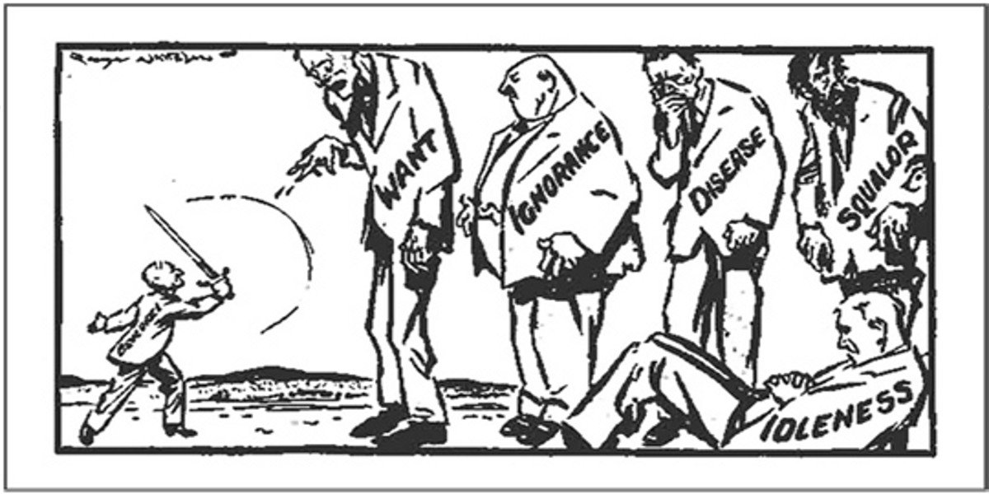
Title
Sub-title
Bullet points;
Bullet points;
Bullet points.
Tweet us! @TISScotland
Tweet us! @TISScotland

Slide 24
The Beveridge Report
The Five Giants of poverty
Title
Sub-title
Bullet points;
Bullet points;
Bullet points.
Tweet us! @TISScotland
Tweet us! @TISScotland

Slide 25

Financial pressures
1 in 4 children in Scotland live in poverty
1 in 5 working age people live in poverty
63% of social rented sector households and 40% in PRS are financially vulnerable
With income of less than £20,000 per year
Tweet us! @TISScotland

Slide 26
Fuel poverty
Title
Sub-title
Bullet points;
Bullet points;
Bullet points.
“61% of tenants feel that their financial circumstances are worse now than prior to the pandemic”
- National Tenants Panel Survey
Tweet us! @TISScotland
Tweet us! @TISScotland

Slide 27

Can we afford our homes?
Title
Session Outline
“More than two thirds of tenants (71%) were concerned about future affordability of their rent”
“Real concerns about lowering housing standards if rent controls applied”
“Strong framework for tenants and housing organisations working together to set affordable rents”
“Hardship support needed especially for tenants who do not receive any support with rents”
Sub-title
What is scrutiny?
Why scrutiny is good for you
The Cunninghame Scrutiny Group
Bullet points;
Bullet points;
Bullet points.
Tweet us! @TISScotland
Tweet us! @TISScotland

Slide 28
Fuel poverty
“More than half of respondents had experienced difficulty heating their home due to high energy costs”
Title
Session Outline
Sub-title
What is scrutiny?
Why scrutiny is good for you
The Cunninghame Scrutiny Group
Bullet points;
Bullet points;
Bullet points.
24% of households live in fuel poverty
Growing concern about damp and mould
Government intervention needed
Tweet us! @TISScotland
Tweet us! @TISScotland

Slide 29

Are we doing enough?
“There has never been a more important time for tenants and housing organisations to work together”
Title
Session Outline
Sub-title
What is scrutiny?
Why scrutiny is good for you
The Cunninghame Scrutiny Group
Bullet points;
Bullet points;
Bullet points.
Bullet points;
Bullet points;
Bullet points.
Tweet us! @TISScotland
Tweet us! @TISScotland

Slide 30

Thank you
Tenants Information Service
Clockwise, 77 Renfrew Street
Glasgow, G2 3BZ
T: 0141 248 1242 E: info@tis.org.uk W: tis.org.uk
Tweet us! @TISScotland
Tweet us! @TISScotland

Slide 31


Cost of Living Crisis: hardship and heartache
www.eas.org.uk
#EssentialWarmth

Slide 32
Causes and Effects of Fuel Poverty
Low incomes
Energy inefficient homes
Behaviour
High fuel costs
Under Occupancy
Fuel Poverty
Heat the home to an appropriate temperature
Don’t heat the home to an appropriate temperature
Condensation & Dampness
ILLNESS
Housing Disrepair
Fuel Debt

Slide 33
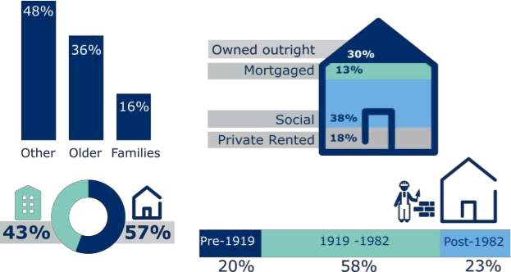
Who is most likely to be affected?

Slide 34
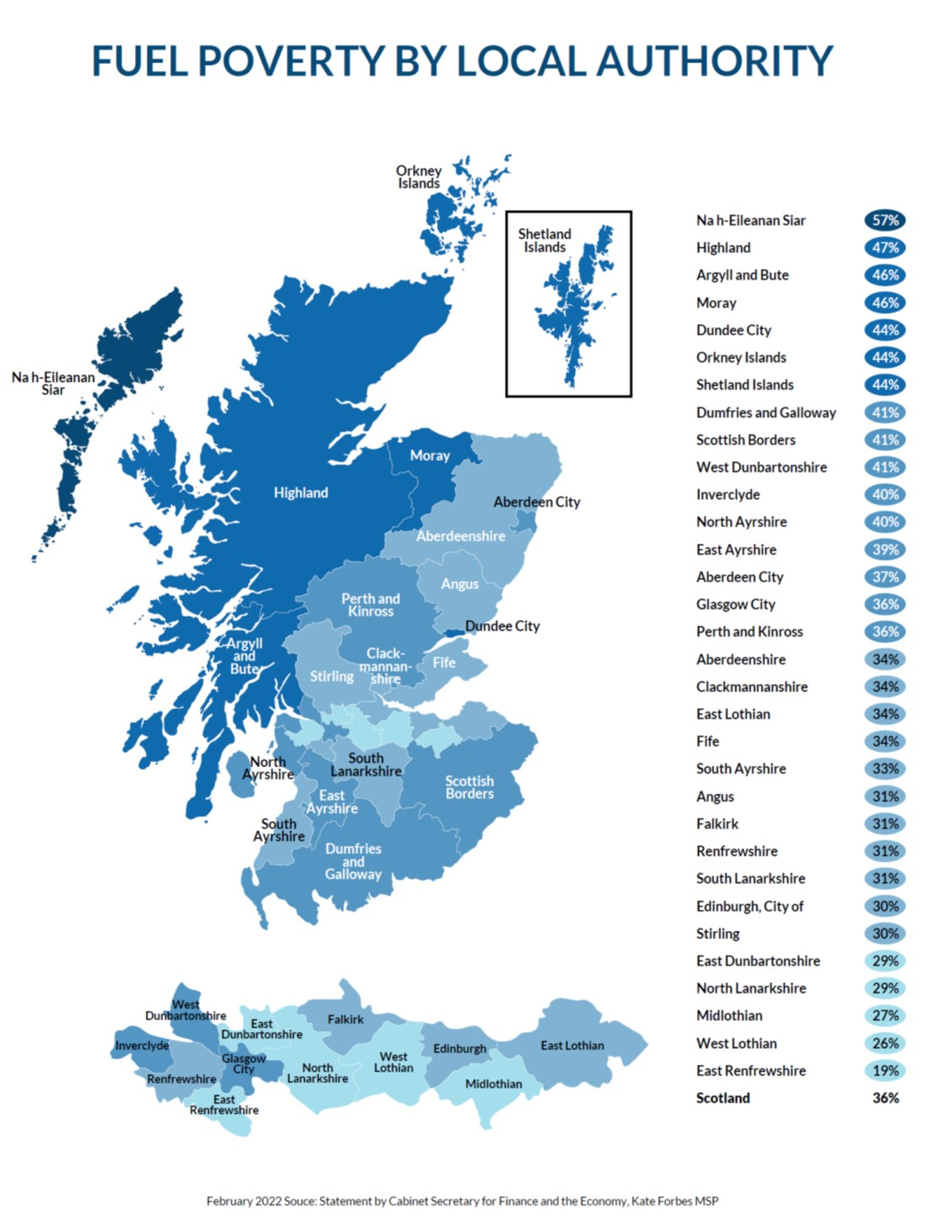

Depends where you live?
Income levels
House types
Fuel availability
Local climate
Tenure

Slide 36
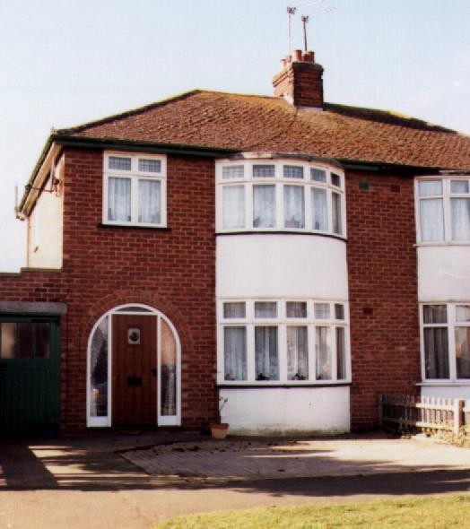
Where the heat goes
25
Roof
Walls
35
Draughts
15
10
Windows
15
Floors

Slide 37
Support Programmes – Scotland
E N E R G Y A C T I O N S C O T L A N D
Home Energy Efficiency Programmes for Scotland
  Area-based schemes
  Warmer Homes Scotland
  Home Energy Scotland Loan Scheme
Local Authority/Housing Provider Projects
Home Energy Scotland
  Advice and information
  Referral and signposting
    inc. tariff checks, benefit checks

Slide 38
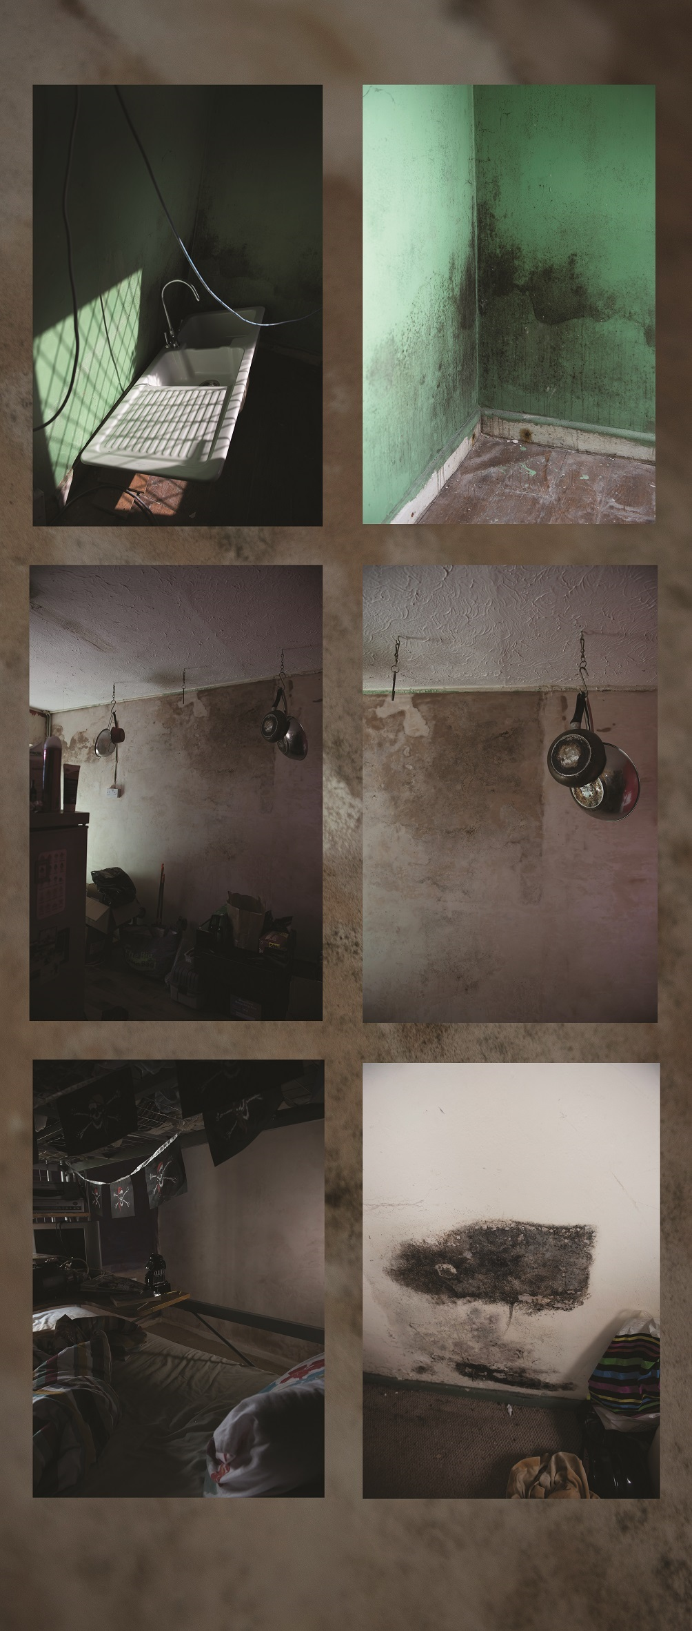

Just and Fair

