Slide 1

CIH All-Ireland Summit 2025
4 November 2025
10:15 – 11:00 | Government updates from the Department for Communities and Department of Housing, Local Government and Heritage
David Polley, director of housing supply policy, Department for Communities Paul Benson, assistant secretary of the social housing division, Department of Housing, Local Government and Heritage Annemarie Farrelly, chief executive, Fingal County Council | Sarah Daly, Associate director: sustainability, Turner & Townsend Advisory Cecily Church, Sustainability manager, The Guinness Partnership Session chair: Rachael Williamson, Head of policy and external affairs, Chartered Institute of Housing
Session sponsor:

Slide 2


Housing Supply
Strategy, Policy and Approaches
David Polley
Director, Housing Supply Policy
CIH All-Ireland Summit - 4th November 2025

Slide 3



Strategic Context
Executive Housing Supply Strategy: Published
Vision: “Everybody has access to a good quality, affordable and sustainable home that is appropriate for their needs and is located within a thriving and inclusive community.”
Programme for Government: Housing priority & targets
Housing Supply Strategy Action Plan
First 3-year plan being finalised

Slide 4

Affordable/Mixed Tenure Housing
Intermediate Rent
Co-Own Shared Housing
Mixed Tenure

Slide 5

Homelessness
Prevention
Move on

Slide 6

Reviews - Policy & Legislation
Decent Homes Standard (DHS)
Tenancy Fraud
Disabled Facilities/Private Sector Grants
Private Rented Notice to Quit

Slide 7
CIH All-Ireland Summit 2025
4 November 2025
12:10 – 12:55 | Use of technology and Artificial Intelligence (AI) in housing
Chris Curran, digital services manager, North and East Housing Association Bobby McConnell, resident, Radius Housing Chair: Laura O’Dowd, director of housing, Ark Housing Association | Sarah Daly, Associate director: sustainability, Turner & Townsend Advisory Cecily Church, Sustainability manager, The Guinness Partnership Session chair: Rachael Williamson, Head of policy and external affairs, Chartered Institute of Housing
Session sponsor:

Slide 8


Slide 9
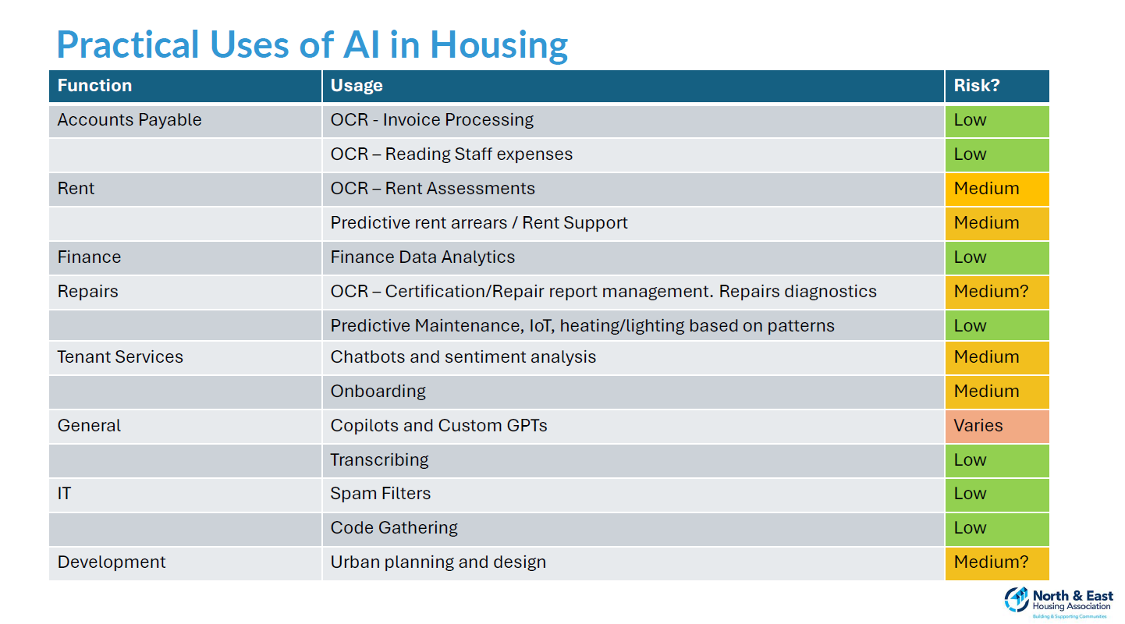

Slide 10
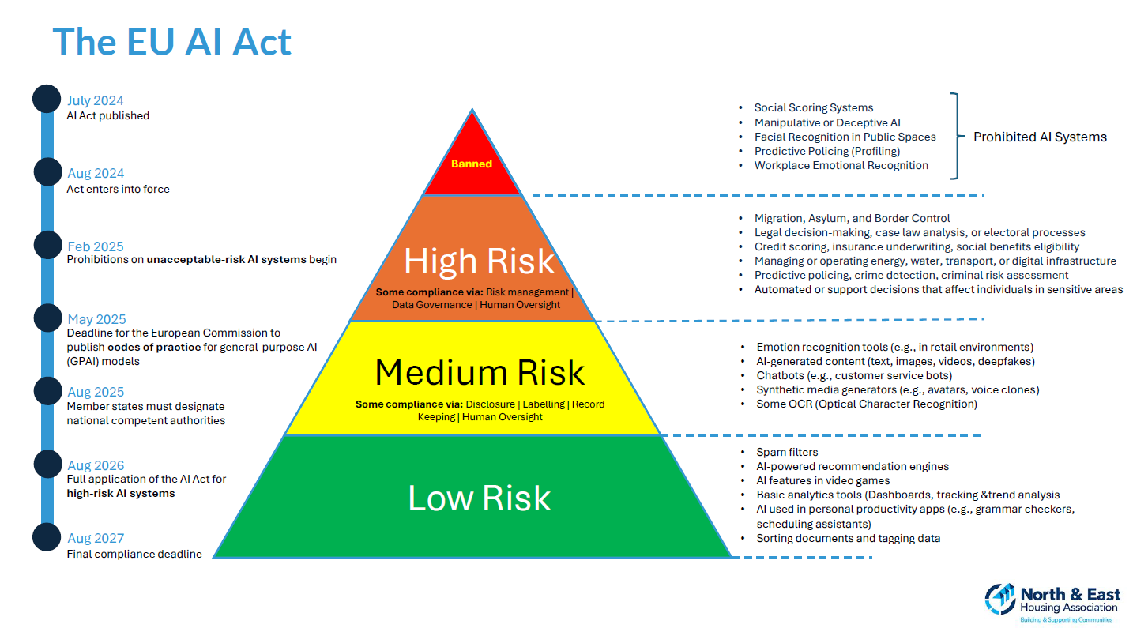

Slide 11
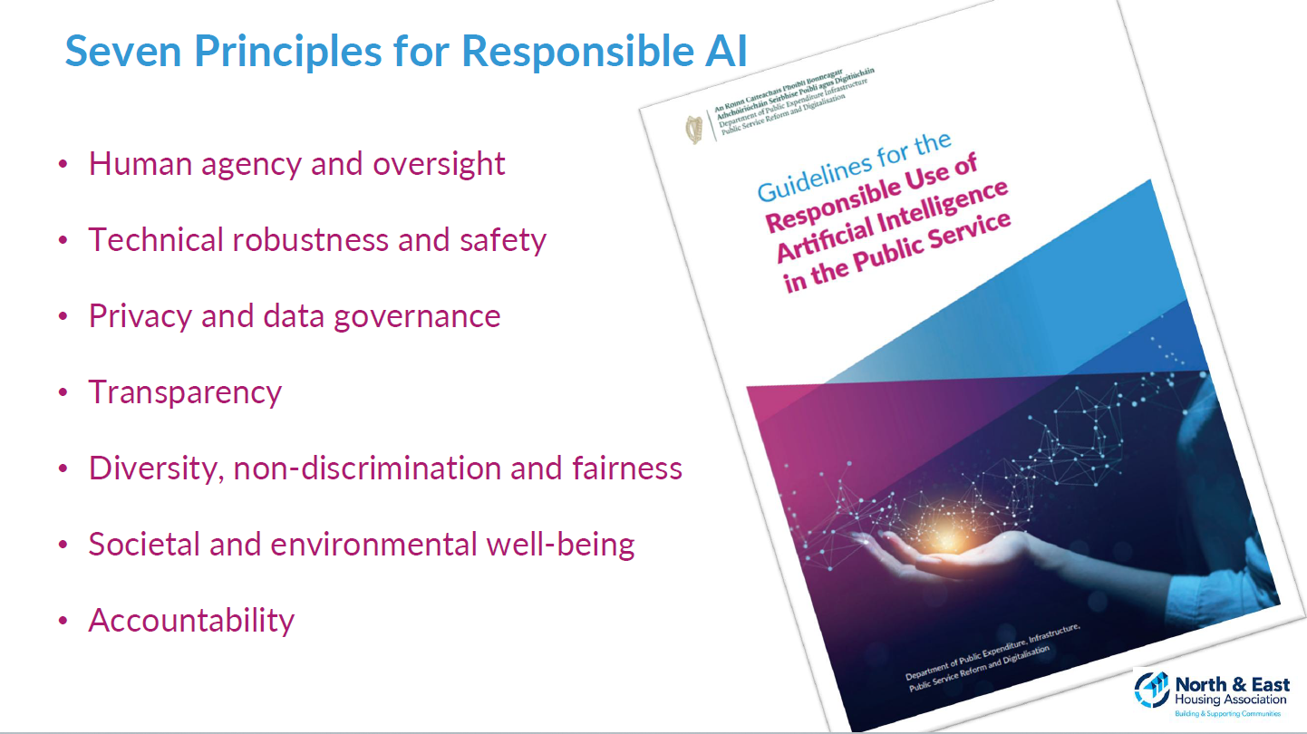

Slide 12
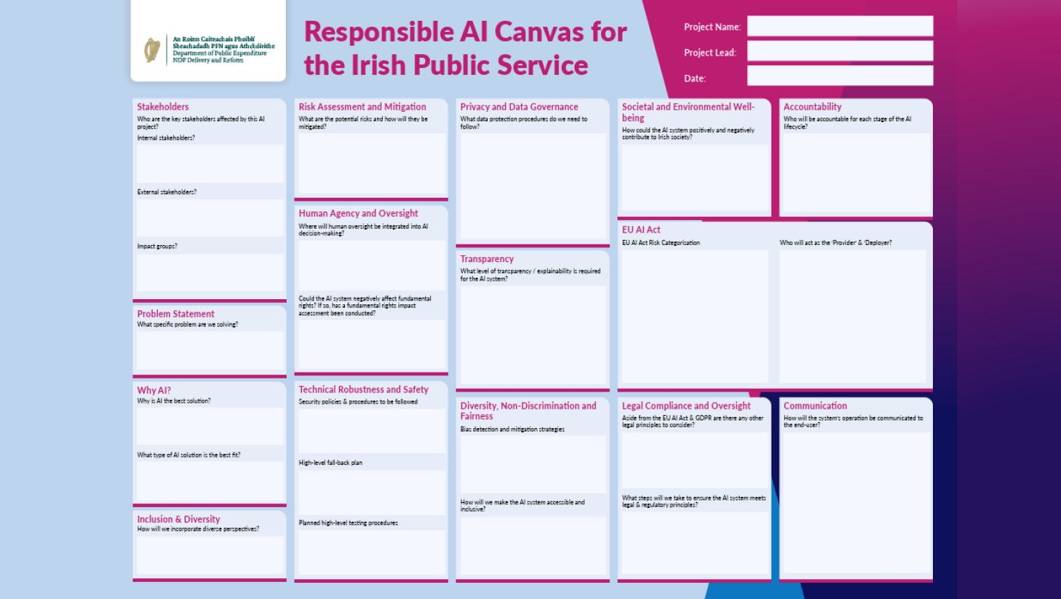

Slide 13
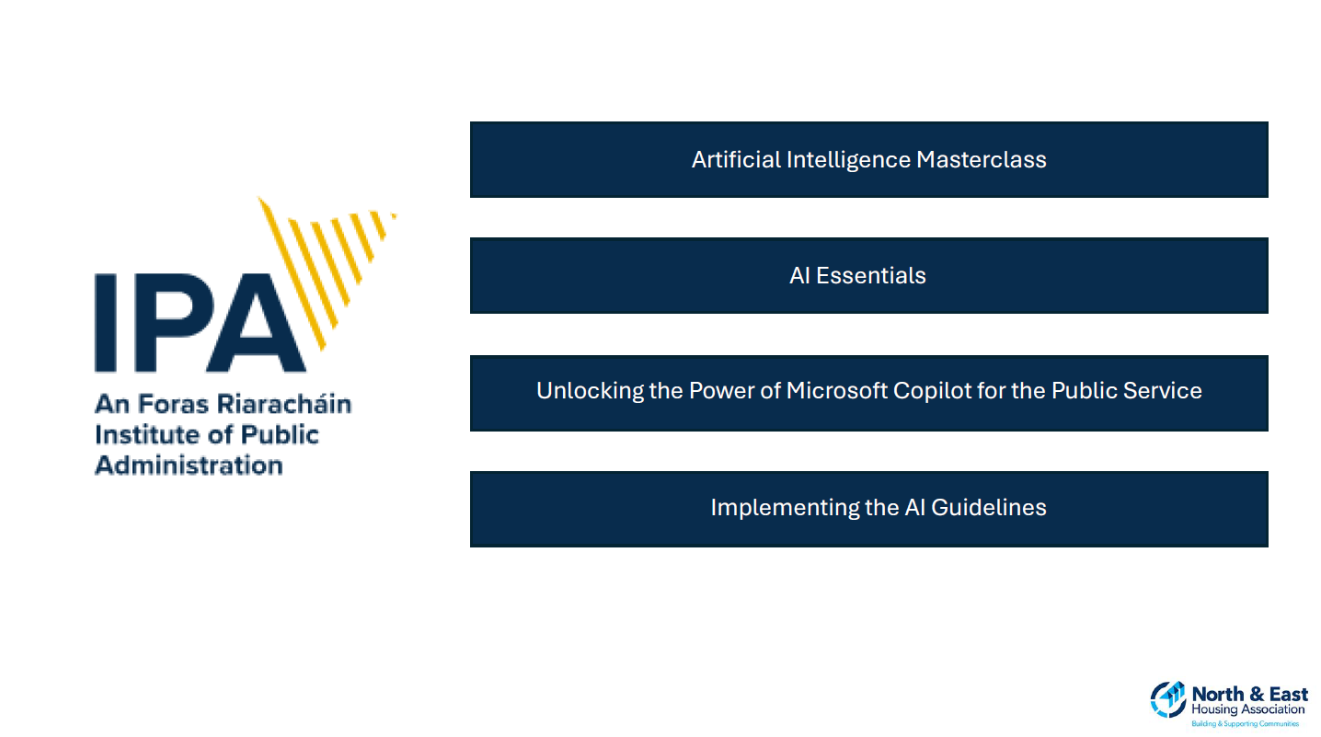

Slide 14


Slide 15
CIH All-Ireland Summit 2025
4 November 2025
14:45 – 15:30 | In discussion: The challenges of sustainability in housing
Brian Rankin, sustainability and energy manager, Choice Housing David McCourt, head of asset management, Co-operative Housing Jennifer Whitey, sustainability manager, Tuath Housing Chair: Paddy Gray OBE, chair of the board of directors, Tuath Housing | Sarah Daly, Associate director: sustainability, Turner & Townsend Advisory Cecily Church, Sustainability manager, The Guinness Partnership Session chair: Rachael Williamson, Head of policy and external affairs, Chartered Institute of Housing
Session sponsor:

Slide 16



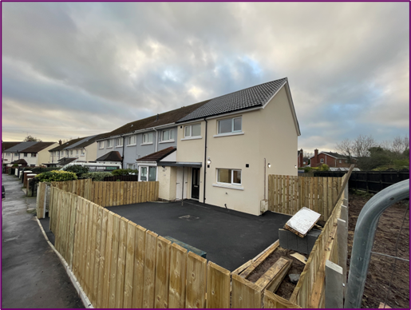
Session sponsor:

Slide 17

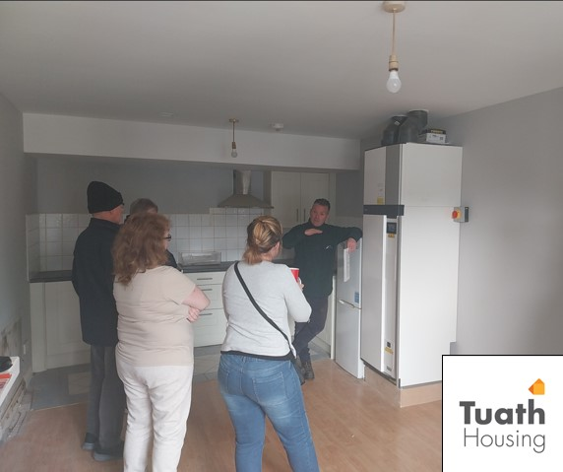
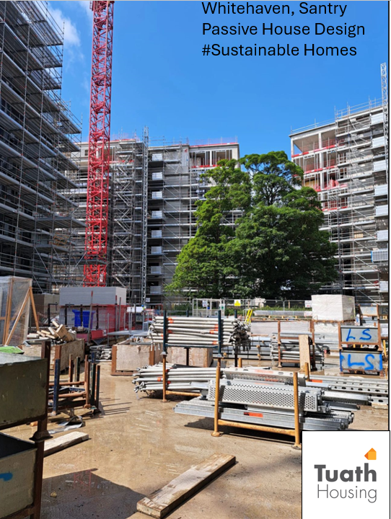
“Before the retrofit, I was constantly cold here. Even with the heating on full, the house never felt warm and my energy bills were through the roof. Since the work was done, it’s like living in a completely different home. I wake up feeling cosy, even on the coldest mornings, and my heating stays on low all day. I’ve had the best winter yet. My bills have almost halved, and I’m sleeping so much better. The air just feels fresher, too, like I can actually breathe properly again.”

Slide 18
